Slide 1
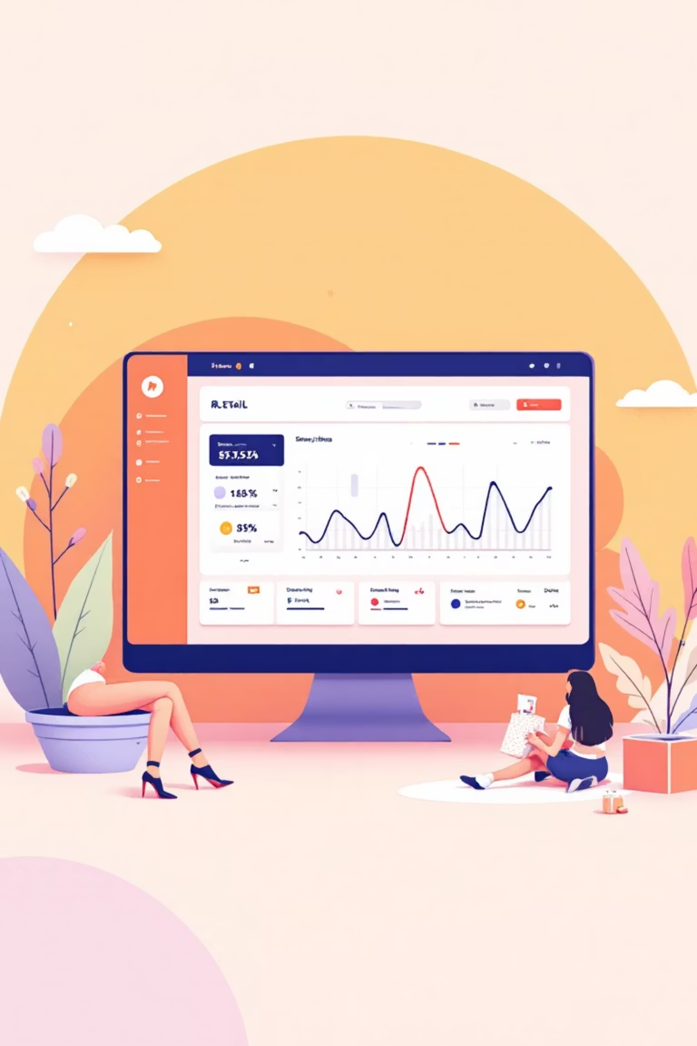
Customer Shopping Behavior Analysis
Uncovering insights from 3,900 purchases to drive strategic business decisions

Slide 2
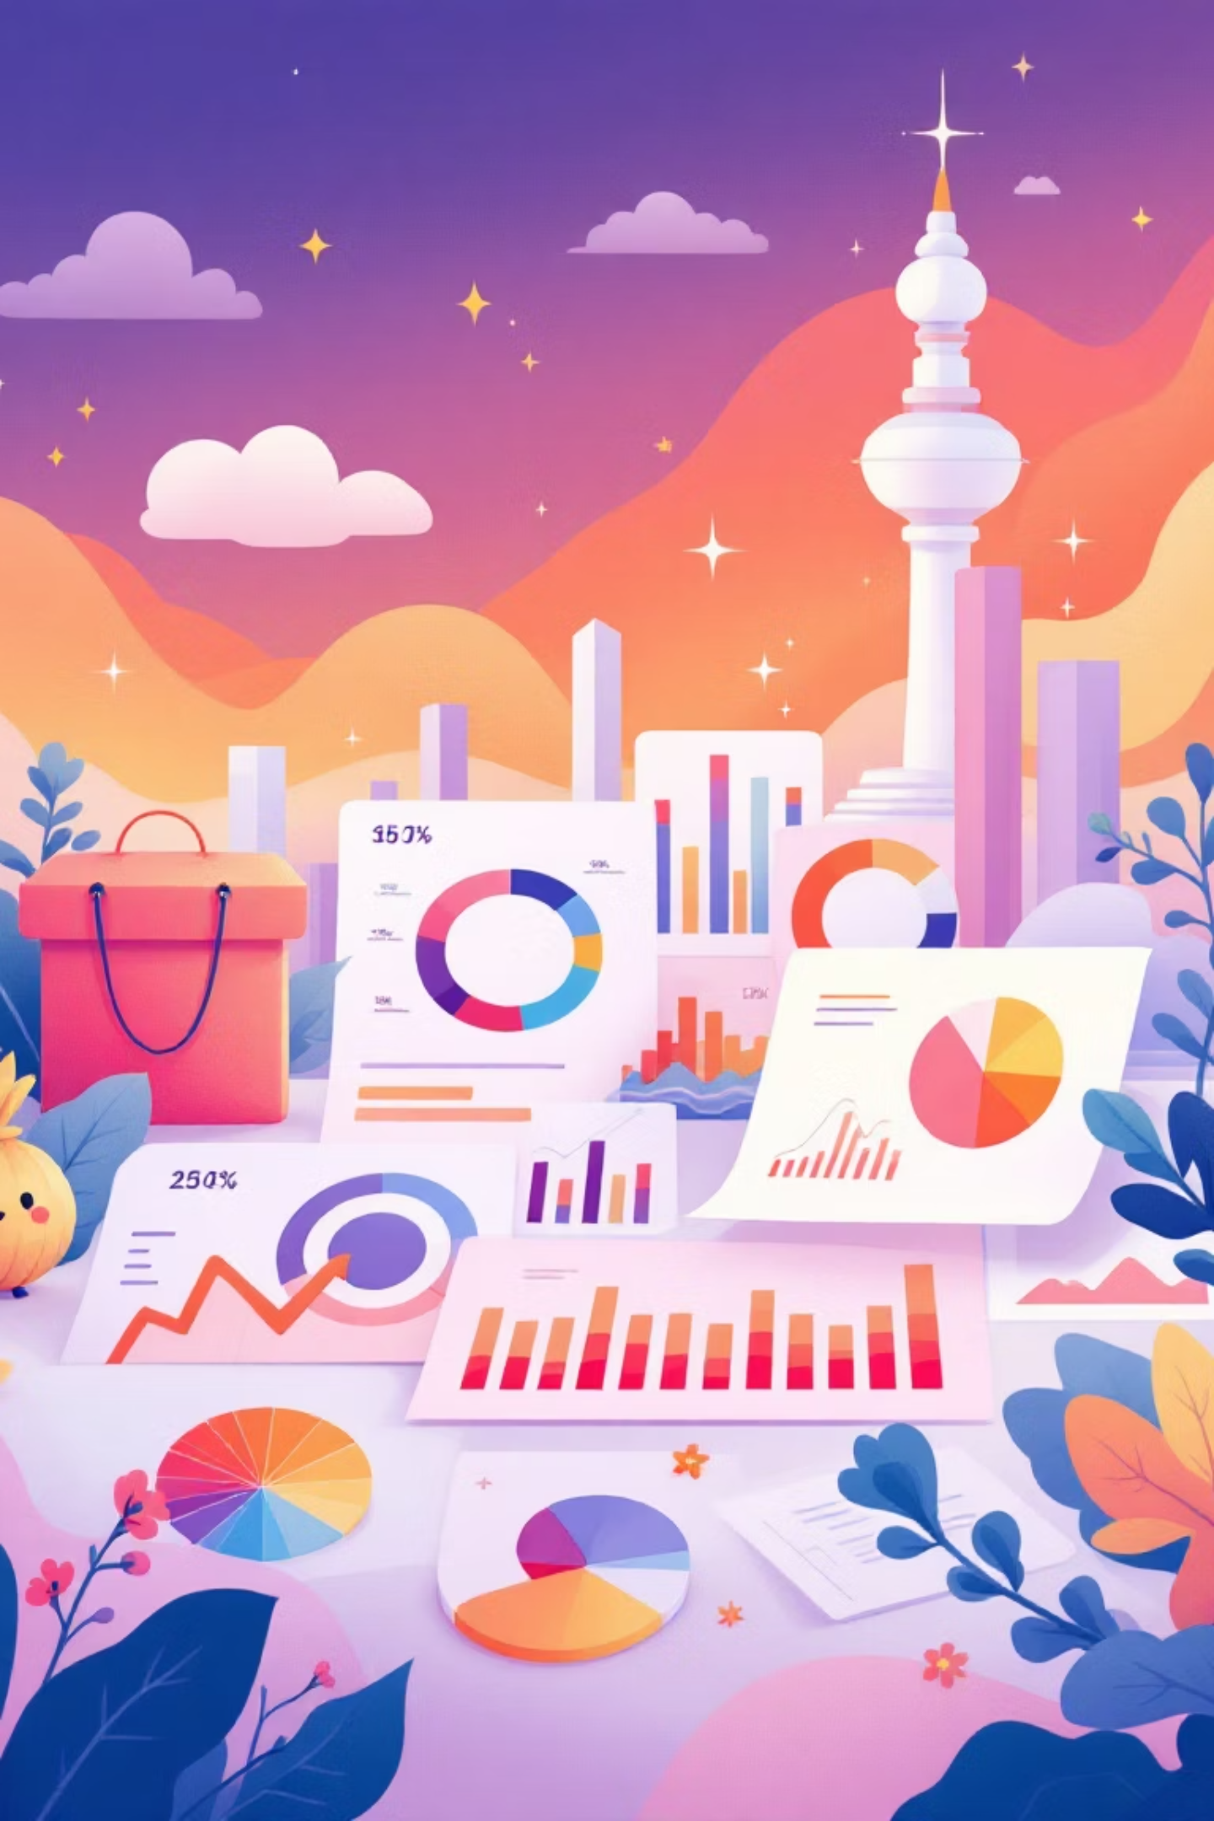
Dataset Overview
3,900
18
50
Total Purchases
Data Columns
Locations
Transactions analyzed
Features tracked
Geographic coverage
25
Products
Items purchased

Slide 3

Data Preparation & Cleaning
01
Data Loading
Imported dataset using pandas, explored structure with df.info()
02
Missing Data
Imputed 37 missing Review Ratings using median by category
03
Feature Engineering
Created age_group and purchase_frequency_days columns
04
Database Integration
Connected to PostgreSQL for SQL analysis

Slide 4
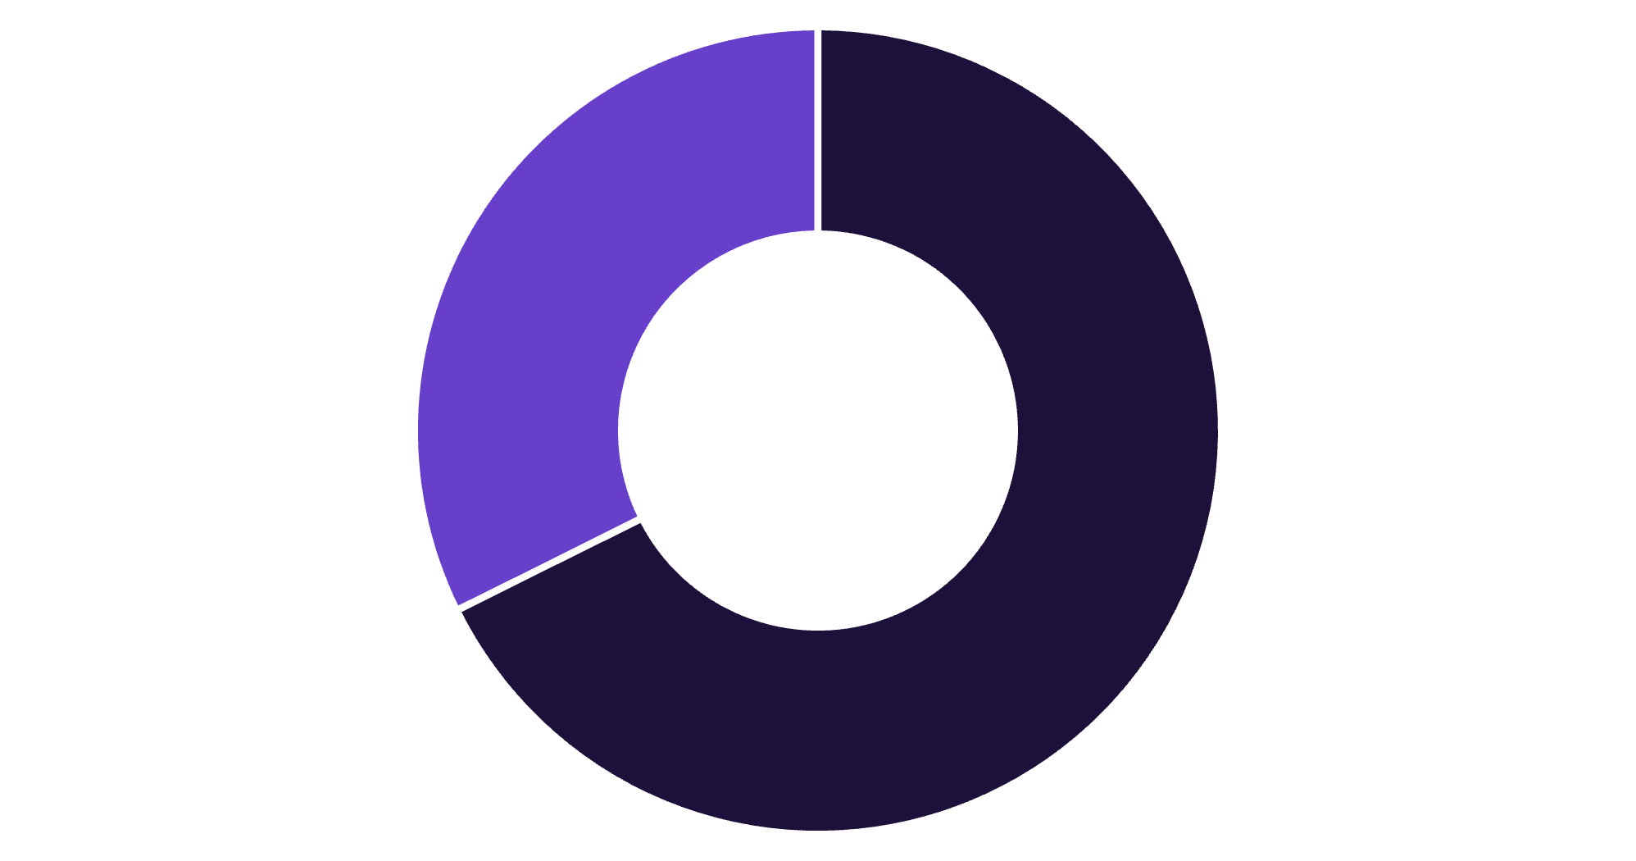
Revenue by Gender
Key Finding
Male customers generate 68% of total revenue
Female segment shows opportunity for targeted growth campaigns
Male
Female

Slide 5
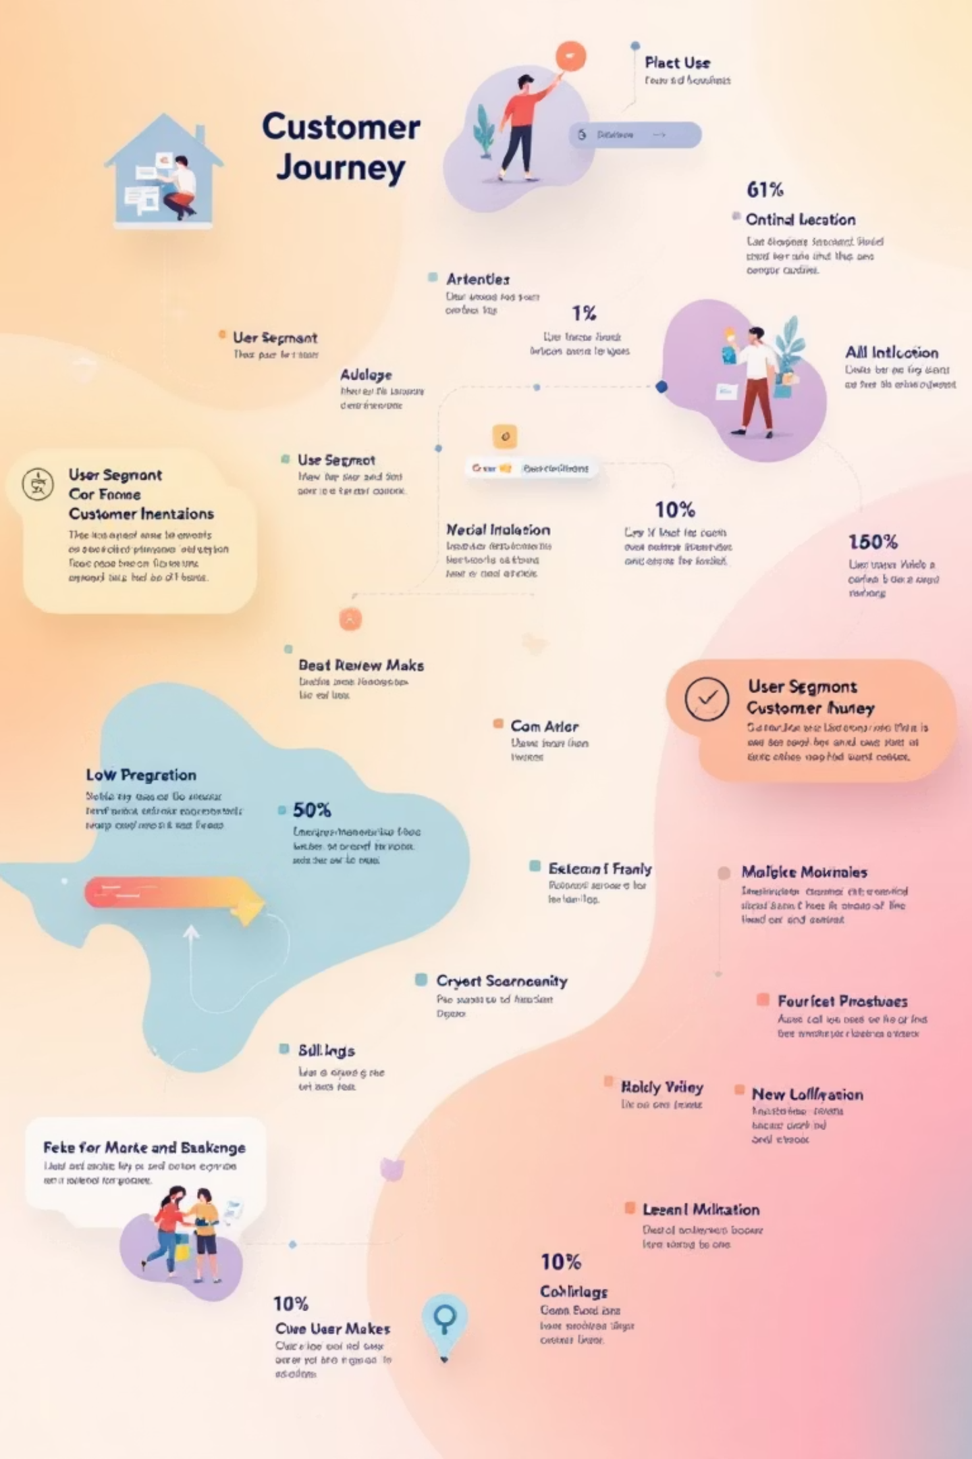
Customer Segmentation Insights
Loyal Customers
Returning Buyers
3,116 customers
701 customers
Largest segment driving repeat business
Growth opportunity segment
New Customers
83 customers
Focus on conversion strategies
High-spending discount users: 839 customers spent above average despite using discounts

Slide 6

Top Performing Products
Highest Rated Items
Most Discount-Dependent
Gloves – 3.86 rating
Sandals – 3.84 rating
Hat – 50% discount rate
Boots – 3.82 rating
Sneakers – 49.66%
Hat – 3.80 rating
Coat – 49.07%
Skirt – 3.78 rating
Sweater – 48.17%
Pants – 47.37%

Slide 7

Subscription Analysis
Subscribers
Non-Subscribers
1,053 customers
2,847 customers
Average spend: $59.49
Average spend: $59.87
Total revenue: $62,645
Total revenue: $170,436
Repeat buyers (>5 purchases): 958 subscribers vs 2,518 non-subscribers

Slide 8
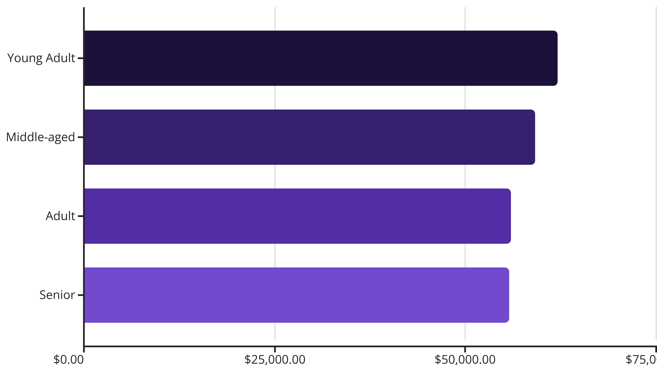
Revenue by Age Group
Young adults lead revenue generation, followed closely by middle-aged customers

Slide 9

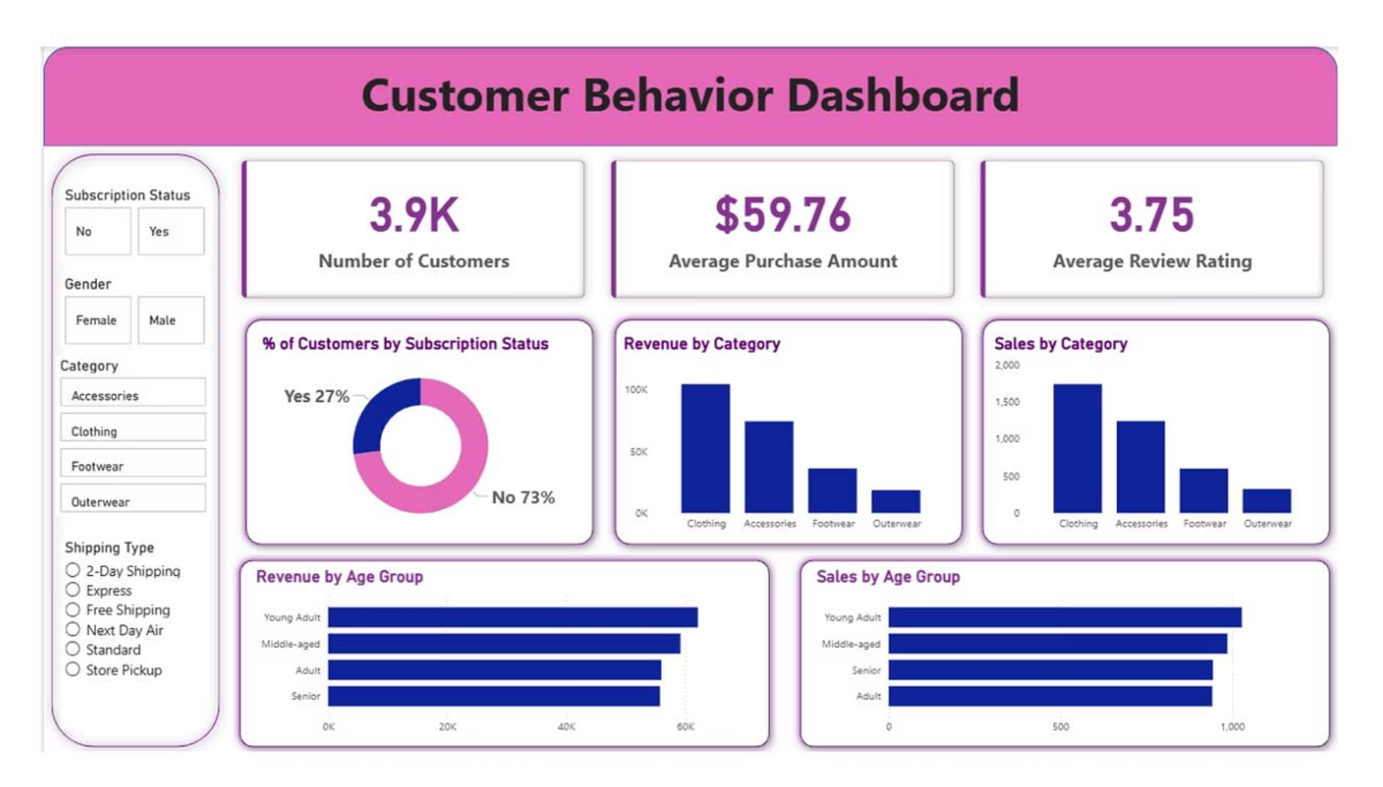
Power BI Dashboard
Interactive visualization presenting key insights across customer segments, products, and revenue streams

Slide 10

Strategic Recommendations
Boost Subscriptions
Loyalty Programs
Review Discounts
Promote exclusive benefits to convert high-frequency buyers
Reward repeat buyers to grow loyal customer segment
Balance sales boosts with margin control strategies
Product Positioning
Targeted Marketing
Highlight top-rated items in marketing campaigns
Focus on high-revenue age groups and express shipping users

